Slide 1


Real-Time Space Mission Dashboard
This presentation explores the creation of a captivating dashboard using Power BI , showcasing real-time data from space missions. We will explore how to visualize mission details, launch frequencies, and success rates, providing comprehensive insights into the dynamic world of space exploration.
by Anjali Khare

Slide 2
Introduction: Capturing the Essence of Space Exploration
Space exploration is a captivating field that pushes the boundaries of human knowledge. Our dashboard aims to capture the essence of this pursuit by visualizing real-time data from space missions.
By leveraging data visualization tools like Power BI or Tableau, we can transform raw data into actionable insights, providing a clear picture of the latest space exploration activities.

Slide 3
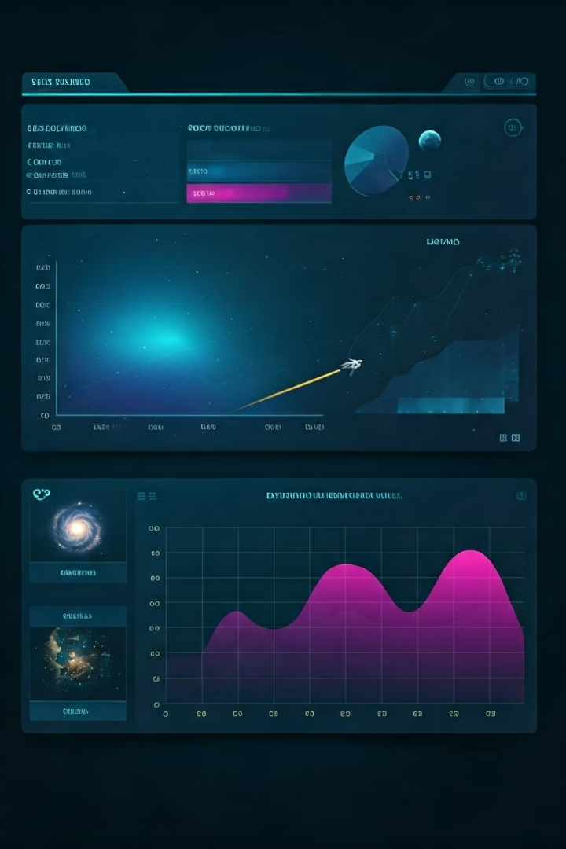



Visualizing Mission Details: Tracking Launch Frequencies and Success Rates
Launch Frequencies
Mission Success Rates
Track the number of launches occurring each month and year, highlighting trends and patterns in space exploration.
Analyze the success rates of different types of missions, identifying areas of strength and potential areas for improvement.
Mission Durations
Explore the durations of various space missions, gaining insight into the complexity and duration of space exploration endeavors.

Slide 4

Data Sources and Preparation: Leveraging Real-Time Space Mission Data
1
Data Sources
2
Data Cleaning and Transformation
Utilize reliable sources of real-time space mission data, such as NASA's open-source data portals or commercial space industry data providers.
Clean and transform the data, ensuring data integrity, consistency, and compatibility with Power BI or Tableau.
3
Data Modeling
Model the data relationships, creating a structured foundation for efficient data analysis and visualization within the chosen platform.

Slide 5



Building the Power BI/Tableau Dashboard: Transforming Data into Actionable Insights
Data Connection
1
Connect the data source to Power BI or Tableau, establishing a secure and reliable data pipeline.
Visualization Selection
2
Choose appropriate chart types for each data point, ensuring clear and engaging representation of the data.
Dashboard Design
3
Create a visually appealing and user-friendly dashboard layout, organizing information logically and strategically.

Slide 6
Interactive Charting and Dashboarding Techniques
Filters
1
Implement interactive filters to allow users to customize the data displayed, focusing on specific missions, time periods, or launch locations.
Drill-Down Capabilities
2
Enable users to drill down into individual missions, exploring specific details and data points, such as mission objectives, launch locations, and orbital parameters.
Data Storytelling
3
Use data visualization techniques to communicate key insights, creating a narrative arc that guides users through the dashboard and highlights key trends and findings.

Slide 7

Monitoring Mission Milestones and Key Performance Indicators
1
Mission Milestones
Track key mission milestones, such as launch dates, orbital insertion, and mission completion, highlighting significant events in the space exploration journey.
2
Key Performance Indicators (KPIs)
Visualize critical KPIs, such as mission success rates, launch frequency, and fuel consumption, providing a comprehensive view of mission performance.
3
Data Alerts
Implement data alerts to notify users of important events, such as mission delays, unexpected changes, or critical performance deviations.

Slide 8
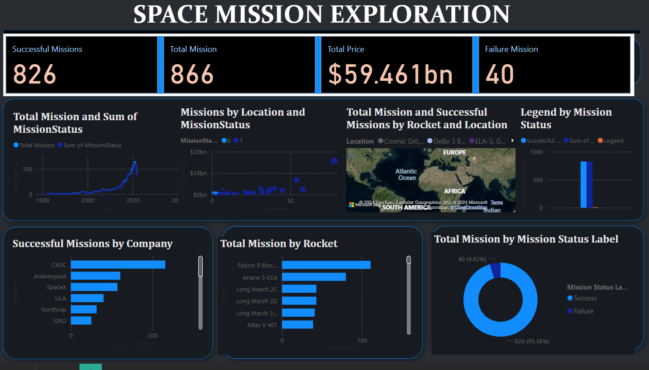

Slide 9

Conclusion: Empowering Space Agencies and Enthusiasts with Comprehensive Insights
This real-time space mission dashboard serves as a powerful tool for space agencies, researchers, and enthusiasts alike, providing valuable insights into the fascinating world of space exploration. It empowers decision-making, fuels scientific advancements, and inspires the next generation of space explorers.

